Slide 1

Welcome to . Project JoinYou
A Basic Social Blog Database Application

Slide 2
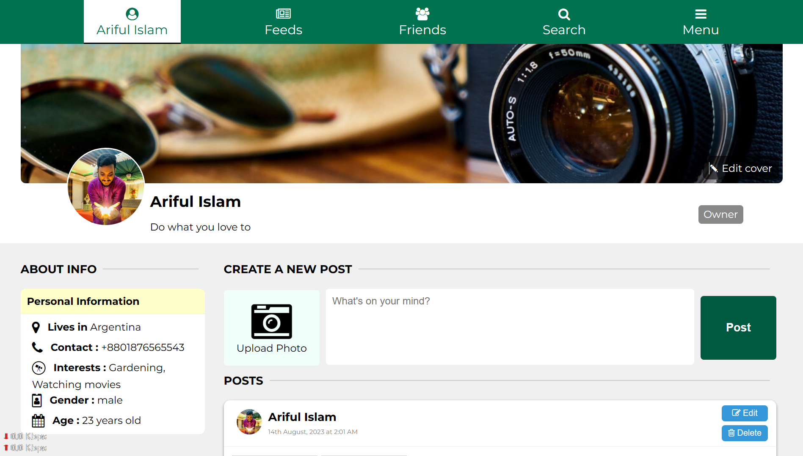
Inroducing Profile Page

Slide 3
Introduction
Introduction
In today's digital age, social networking is essential.
Our project caters to modern social networking demands.
Provides hands-on experience for students.

Slide 4

Core Idea
Core Idea
Users can create profiles, share posts, and connect.
Comprehensive solution for social interaction.
Fosters a sense of online community.

Slide 5
Methodology
User Panel: Registration, Login, Profile Management, Friend Requests, Posting Content, Interactions, Viewing User Posts, User Search.
Admin Panel: Admin Login, User Management, User Posts Management, User Profile Management, Data Analytics.

Slide 6
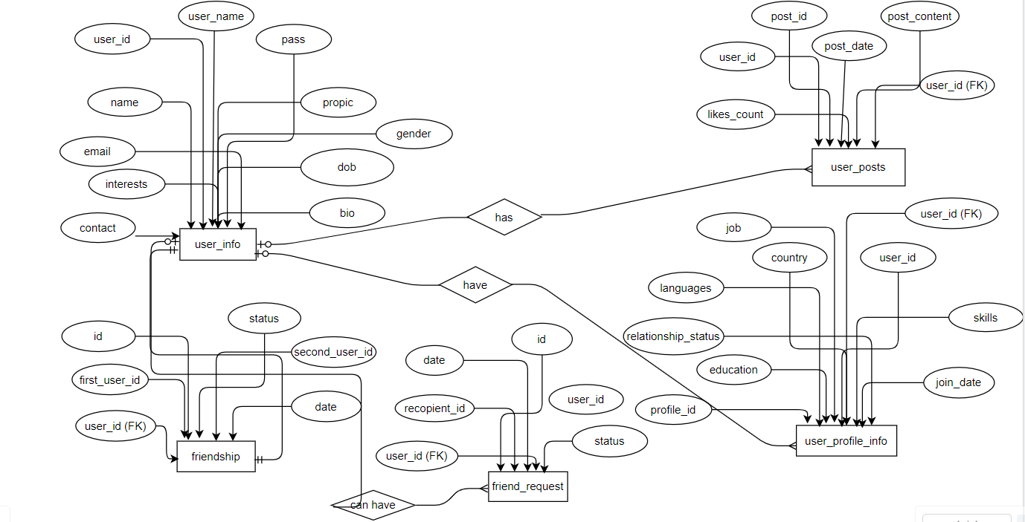
Database Design (ER-Diagram)

Slide 7
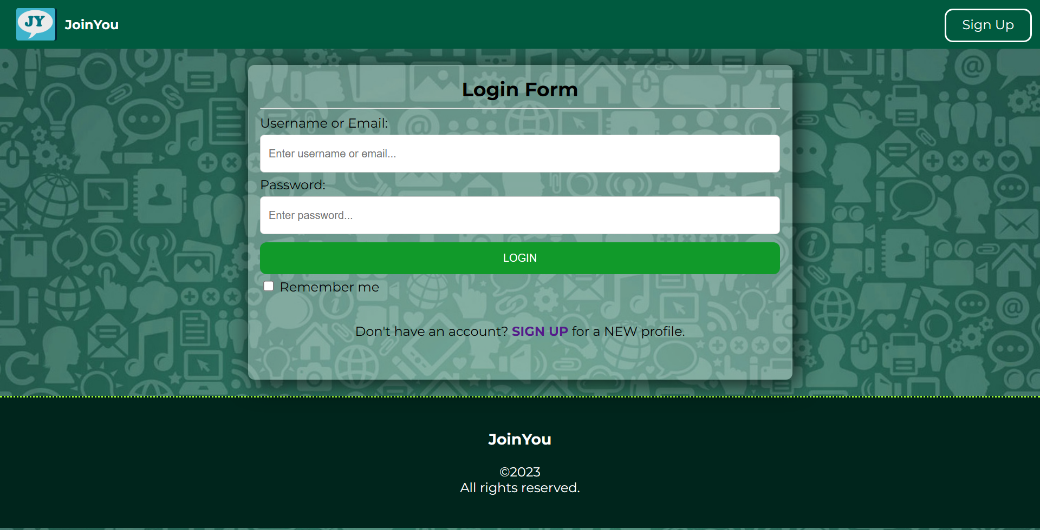
System Outputs
Login Page

Slide 8
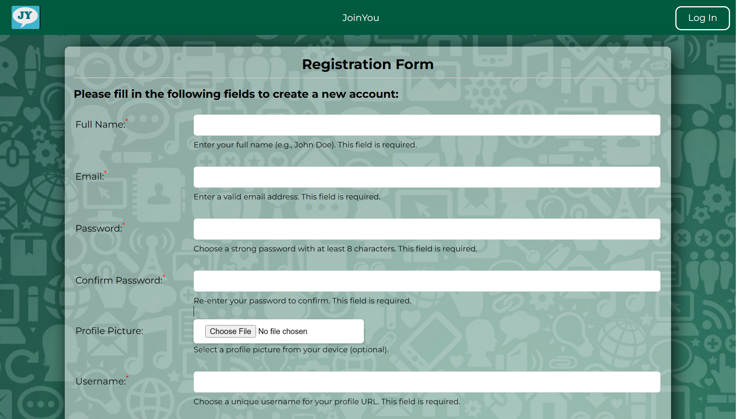
System Outputs
Sign UP Page

Slide 9
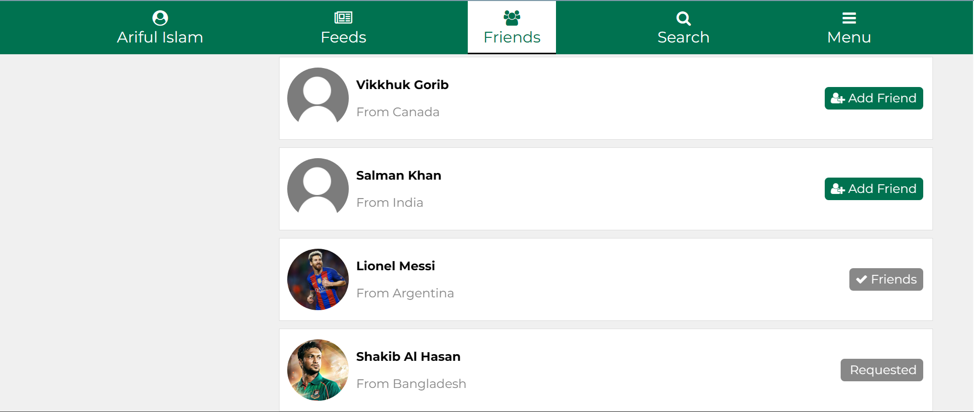
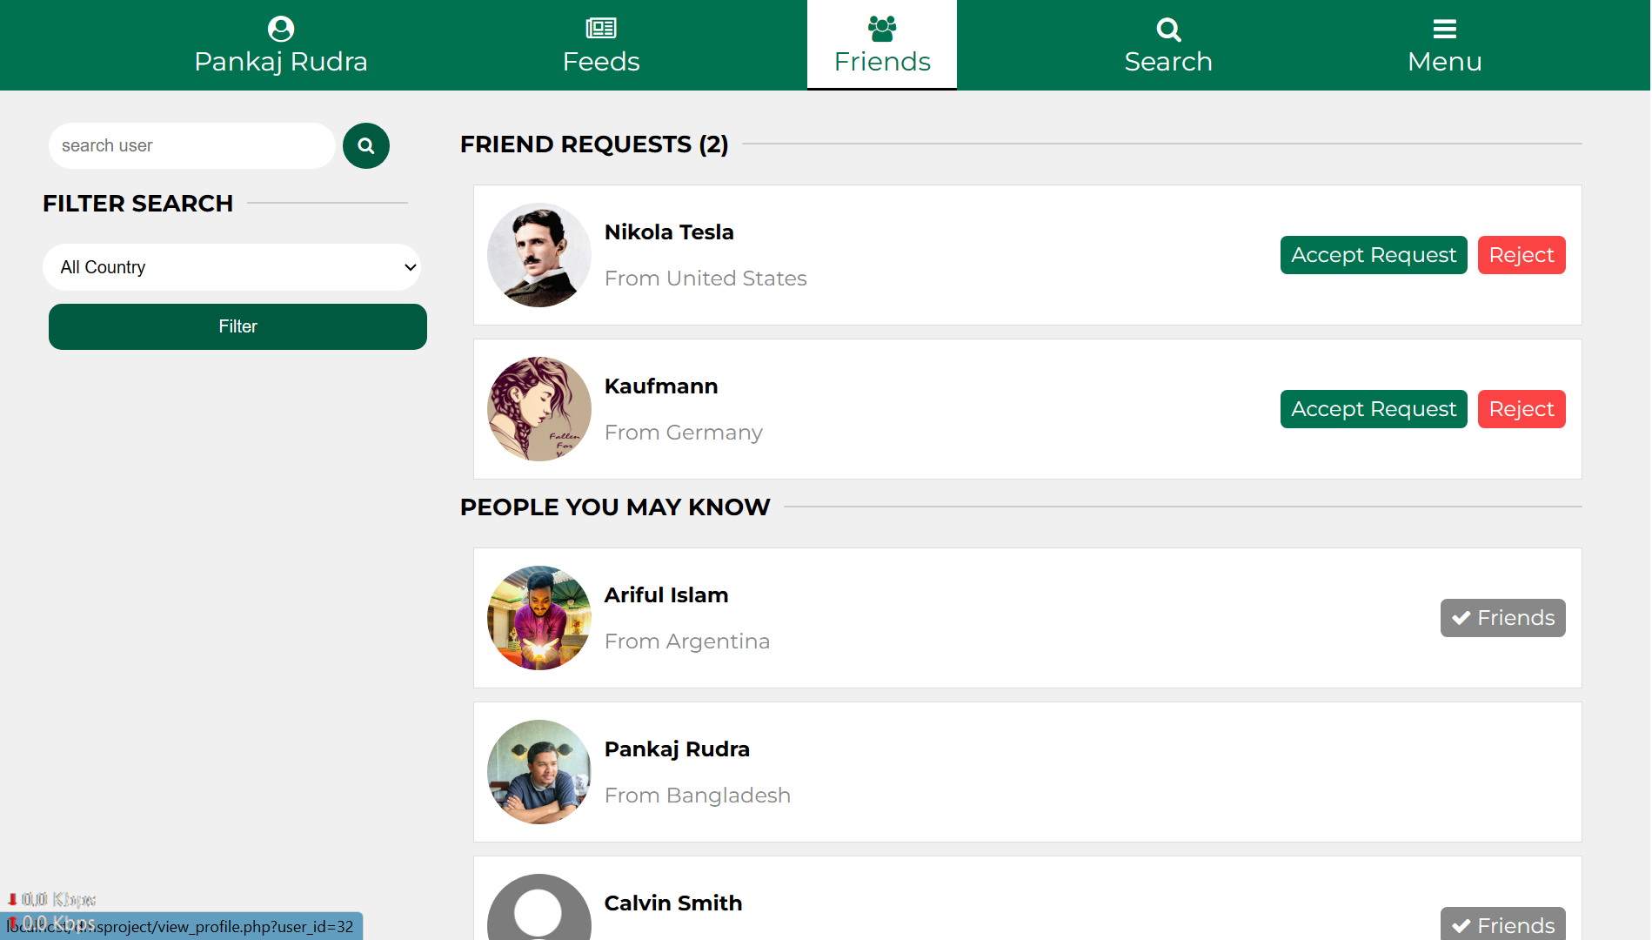
System Outputs
Connect
With
others

Slide 10
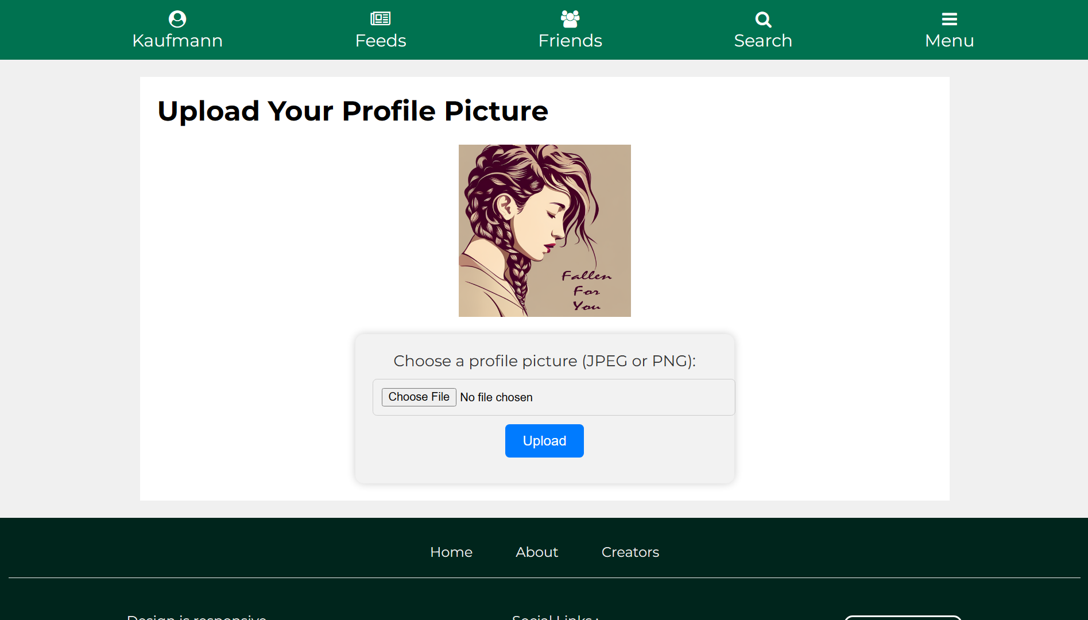
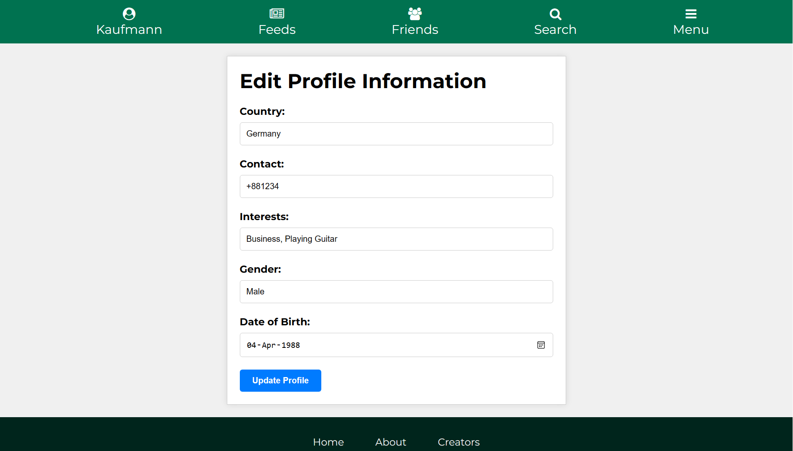
System Outputs
Edit profile

Slide 11
Thank You
For any query contact:
Pankaj Rudra and Ariful Islam
ariful.sohelrana@gmail.com

